Slide 1
Course – DBMS
Course Instructor
Dr.Karanam Sunil Kumar
Department of CSE, BMSCE
9 December 2022
CSE, RVCE

Slide 2
Instruction to Students
Apart from the contents presented in the slides students should read through the text book also.
9 December 2022
CSE, RVCE

Slide 3
Unit 2:
Introduction to Relational Algebra
9 December 2022
CSE, RVCE

Slide 4
Why you should Learn “Relational Algebra” ?
9 December 2022

Slide 5
Why you should Learn “Relational Algebra” ?
Relational Algebra is
Core of Relational Query Language, Example: SQL
Provides framework for Query implementation and optimization
Is a mathematical language for manipulating relations.
9 December 2022

Slide 6

Relational Algebra based on Relational Model
student_info
Won Turing award 1981
USN | Name
1BM14CS001 | Arjun
1BM14CS002 | Balaji
Relational model due to Edgar Teds Codd,
a mathematician at IBM in 1970
9 December 2022

Slide 7
Relational Algebra based on Relational Model
student_info
Won Turing award 1981
USN | Name
1BM14CS001 | Arjun
1BM14CS002 | Balaji
Relational model due to Edgar “Ted” Codd,
a mathematician at IBM in 1970
Column or Attribute
Row
or
Tuple
or
Record
USN | Name
1BM14CS001 | Arjun
1BM14CS002 | Balaji
Table
or
Relation
Database table Name: student_info
9 December 2022

Slide 8
RDBMS Architecture
Relational Database Management System (RDBMS)
How does a SQL engine work ?
SQL Query
Relational Algebra (RA) Plan
Optimized RA Plan
Execution
Declarative query (from user)
Find logically equivalent- but more efficient- RA expression
Execute each operator of the optimized plan!
Translate to relational algebra expression
9 December 2022

Slide 9
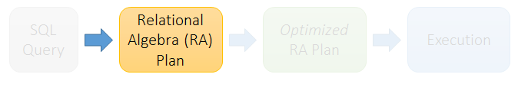
RDBMS Architecture
Relational Database Management System (RDBMS)
How does a SQL engine work ?
Relational Algebra allows us to translate declarative (SQL) queries
into precise and optimizable expressions!
9 December 2022

Slide 10
What is an “Algebra”
Mathematical system consisting of:
  Operands: variables or values from which new values can be constructed.
  Operators: symbols denoting procedures that construct new values from given values.
9 December 2022

Slide 11
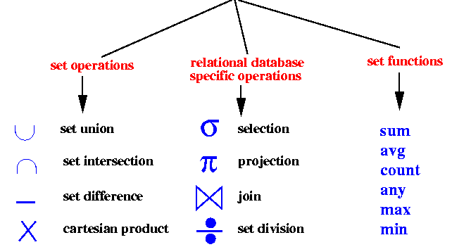
What is Relational Algebra (RA) ?
An algebra whose operands are database tables or relations or variables that represent relations.
Operators are designed to do the most common things that we need to do with relations in a database.
  The result is an algebra that can be used as a query language for relations.
Relational Algebra Operations
9 December 2022

Slide 12

Keep in mind: RA operates on sets!
RDBMSs use multisets, however in relational algebra formalism we will consider sets!
Also: we will consider the named perspective, where every attribute must have a unique name
  →attribute order does not matter…
9 December 2022

Slide 13
Unary Relational Operations
Select Operation (σ sigma)
Project Operation (∏ phi)
9 December 2022

Slide 14
Select Operation (σ sigma)
It selects tuples that satisfy the given predicate from a relation.
Select written as
Notation σ_{selection condition}(R)
Where σ stands for selection predicate
R stands for relation / table name
Selection condition is prepositional logic formula which may use connectors like and, or, and not. These terms may use relational operators like − =, ≠, ≥, < , >, ≤.
9 December 2022

Slide 15
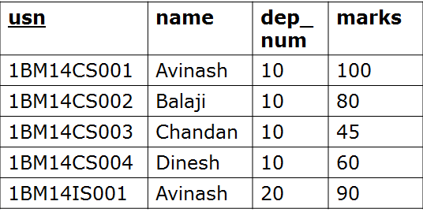
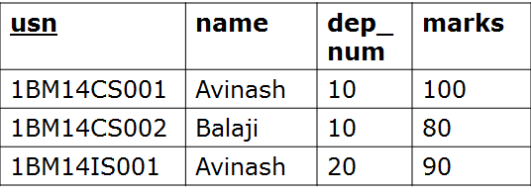
Select Operation (σ)
Select Operation (σ)
Returns all tuples which satisfy a condition
SQL:
σ_{selection condition}(R)
SELECT *
FROM Student
WHERE marks > 60;
Student
Equivalent
Relational Algebra
Expression
9 December 2022

Slide 16

Select Operation (σ)
Select Operation (σ)
Returns all tuples which satisfy a condition
SQL:
σ_{selection condition}(R)
SELECT *
FROM Student
WHERE marks > 60;
Student
Relational Algebra Expression
9 December 2022

Slide 17
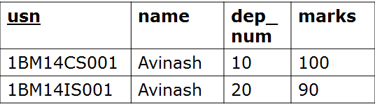
Select Operation (σ)
Select Operation (σ)
Returns all tuples which satisfy a condition
SQL:
σ_{selection condition}(R)
SELECT *
FROM Student
WHERE name=‘Avinash’;
Student
Relational Algebra Expression
9 December 2022

Slide 18
Project Operation (∏ phi)
It projects column(s) that satisfy a given predicate.
Written as
Notation ∏_{A1,…., An} (R)
Where A₁, A₂ , A_{n} are attribute names of relation R.
Duplicate rows are automatically eliminated, as relation is a set.
9 December 2022

Slide 19

Project Operation (∏ phi)
Eliminates columns, then removes duplicates
Written as
Notation ∏_{A1,…., An} (R)
SQL:
SELECT DISTINCT
dep_num
FROM Student;
Student
Relational Algebra Expression
dep_num
10
20
9 December 2022

Slide 20

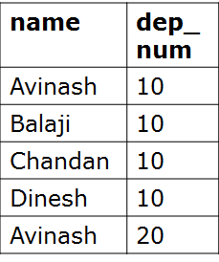
Project Operation (∏ phi)
Eliminates columns, then removes duplicates
Written as
Notation ∏_{A1,…., An} (R)
SQL:
SELECT DISTINCT
name, dep_num
FROM Student;
Student
Relational Algebra Expression
9 December 2022

Slide 21
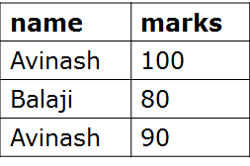
Note that RA Operators are Compositional!
Student
SELECT DISTINCT
name, marks
FROM Student
WHERE marks > 60;
How do we represent this query in Relational Algebra?
9 December 2022

Slide 22
Note that RA Operators are Compositional!
Student
SELECT DISTINCT
name, marks
FROM Student
WHERE marks > 60;
How do we represent this query in Relational Algebra?
9 December 2022

Slide 23

Note that RA Operators are Compositional!
Student
SELECT DISTINCT
name, marks
FROM Student
WHERE marks > 60;
Are these logically equivalent?
9 December 2022
Notes:
Result relation can be the input for another relational algebra operation! (Operator composition.)

Slide 24
Note that RA Operators are Compositional!
Student
SELECT DISTINCT
name, marks
FROM Student
WHERE marks > 60;
How do we represent this query in Relational Algebra?
Are these logically equivalent?
9 December 2022
Notes:
Result relation can be the input for another relational algebra operation! (Operator composition.)

Slide 25
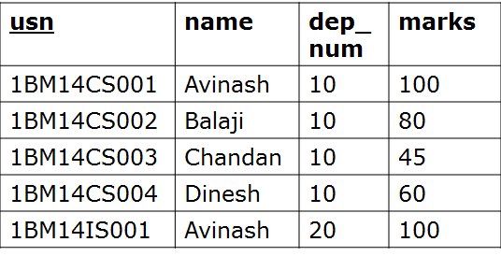
Question
Student
What is the output of following
relational algebra query ?
SELECT DISTINCT
name, marks
FROM Student
WHERE marks > 60;
9 December 2022

Slide 26
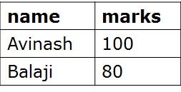
Question
Student
What is the output of following
relational algebra query ?
SELECT DISTINCT
name, marks
FROM Student
WHERE marks > 60;
9 December 2022

Slide 27
Question
Student
What is the output of following
relational algebra query ?
SELECT DISTINCT
usn, name, marks
FROM Student
WHERE marks > 60;
9 December 2022

Slide 28
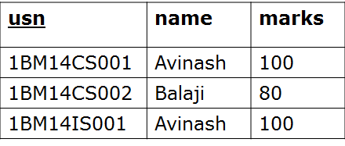
Question
Student
What is the output of following
relational algebra query ?
SELECT DISTINCT
usn, name, marks
FROM Student
WHERE marks > 60;
9 December 2022

Slide 29

Question
Consider the relational schema Schedule containing Theater name, Movie Title and timing at which movie will be played. Time in the Schedule table is stored in 24Hr format i.e., 6:00pm will be stored as 18
Schedule(Theater, MovieTitle, Time)
Write the following query both in Relational Algebra and SQL.
List the theater name and time where we can watch the movie “FindingNemo" after 3pm.
9 December 2022

Slide 30
Question
Consider the relational schema Schedule containing Theater name, Movie Title and timing at which movie will be played. Time in the Schedule table is stored in 24Hr format i.e., 6:00pm will be stored as 18:00
Schedule(Theater, MovieTitle, Time)
Write the following query both in Relational Algebra and SQL.
List the theater name and time where we can watch the movie “FindingNemo" after 3pm.
SELECT Theater, Time
FROM Schedule
WHERE MovieTitle = ’FindingNemo’ AND time >= 15;
9 December 2022

Slide 31
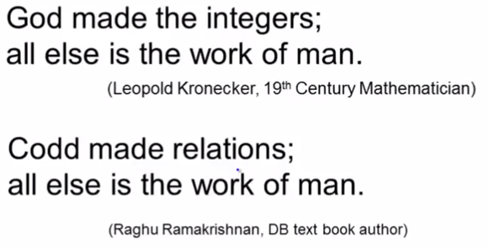
Database Philosophy
Won Turing award 1981
Edgar Ted Codd
9 December 2022

Slide 32
Rename Operation (ρ rho)
The rename operation allows us to rename the either relation name or attribute names or both.
Written as
Notation
ρ_{S(B1,…., Bn)} (R) or ρ_{S}(R) or ρ_{(B1,…., Bn)} (R)
S is the new relation name and B₁, B₂….B_{n} are new attribute names.
9 December 2022

Slide 33
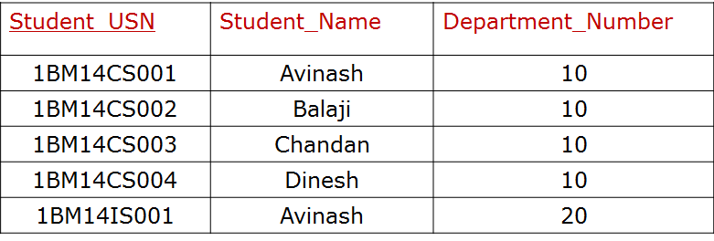
Rename Operation (ρ rho)
The rename operation allows us to rename the either relation name or attribute names or both.
SQL:
Student
SELECT
usn as Student_USN
name as Student_Name
dep_num as Department_Number
FROM Student;
ρStudent_USN, Student_Name, Department_Number (Student)
Student
9 December 2022

Slide 34
Binary Operations
9 December 2022

Slide 35


The CARTESIAN PRODUCT or CROSS JOIN returns the Cartesian product of the sets of records from the two or more joined tables.
Notation: table1 × table2
table1
table2
ID | M
1 | a
2 | b
4 | c
ID | N
2 | p
3 | q
5 | r
Relational Algebra Expression
table1 x table2
9 December 2022

Slide 36
Join Operation
Written as R ⋈_{joincondition} S
9 December 2022

Slide 37
Join Operation
Written as R ⋈_{joincondition} S
Emp_Dept
Dept
Emp_ID | D_ID
121 | 2
240 | 4
D_num | D_name
1 | Sale
2 | Account
4 | Marketing
9 December 2022

Slide 38
Join Operation
Written as R ⋈_{joincondition} S
Emp_Dept
Dept
Emp_ID | D_ID
121 | 2
240 | 4
D_num | D_name
1 | Sale
2 | Account
4 | Marketing
Emp_Dept ⋈_{D_ID=D_num} Dept
Emp_ID | D_ID | D_num | D_name
121 | 2 | 2 | Account
240 | 4 | 4 | Marketing
9 December 2022

Slide 39
Join Written as R ⋈_{joincondition} S
JOIN operation is used to combine related records from two tables into a single records
A general join condition is of the form
<condition> AND <condition> AND……AND <condition>
Where each condition is of the form A_{i} θ B_{j} , A_{i} is an attribute in relation R and B_{j} is an attribute in relation S, Ai and Bj have same domain
  It is called a theta join, if θ is one of the comparison operators {< , > , = , ≠ , ≤ , ≥}.
  Once again, if θ is = it's called an equijoin, and
  if the equijoin is on same-named attributes it's called a natural join and written as *.
Similarly, there are left, right, and full outer joins; written as ⟕, ⟖, and ⟗ respectively.
9 December 2022

Slide 40
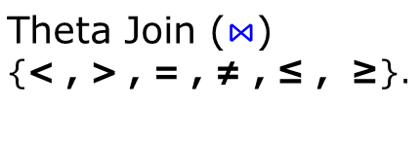

Join Operations
Join
Inner Join
Outer Join
Left Outer Join ⟕
Right Outer Join ⟖
Natural Join(*) (common attribute
names and domain
should exist between
two tables)
Full Outer Join ⟗
9 December 2022

Slide 41
Equi Join
table1
table2
num | M
1 | a
2 | b
4 | c
ID | N
2 | p
3 | q
5 | r
num | M | ID | N
2 | b | 2 | p
Select *
From table1, table2
Where num=id;
What is the equivalent
relational algebra expression ?
9 December 2022

Slide 42

Equi Join
Select *
From table1, table2
Where num=id;
table1
table2
num | M
1 | a
2 | b
4 | c
ID | N
2 | p
3 | q
5 | r
num | M | ID | N
2 | b | 2 | p
result
num | M | ID | N
2 | b | 2 | p
9 December 2022

Slide 43

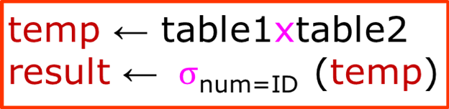
Question
table1
table2
result
num | M
1 | a
2 | b
4 | c
ID | N
2 | p
3 | q
5 | r
num | M | ID | N
2 | b | 2 | p
Are these logically equivalent?
9 December 2022

Slide 44

Natural Join
Natural Join(*): Common attribute names and domain should exist
between two tables.
Natural join does not use any comparison operator. It does not concatenate the way a Cartesian product does. We can perform a Natural Join only if there is at least one common attribute that exists between two relations. In addition, the attributes must have the same name and domain.
Natural join acts on those matching attributes where the values of attributes in both the relations are same.
table1
table2
ID | M
1 | a
2 | b
4 | c
ID | N
2 | p
3 | q
5 | r
result
ID | M | N
2 | b | p
9 December 2022

Slide 45

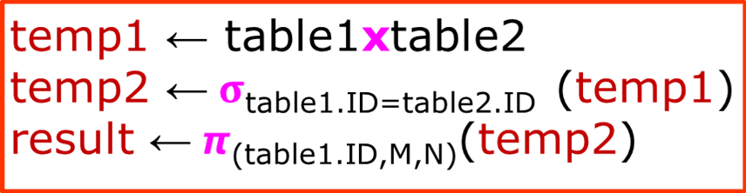
Question
table1
table2
result
ID | M
1 | a
2 | b
4 | c
ID | N
2 | p
3 | q
5 | r
ID | M | N
2 | b | p
Are these logically equivalent?
9 December 2022

Slide 46
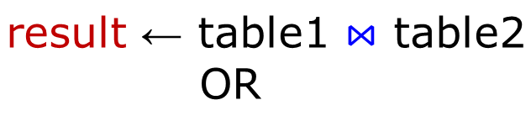

Natural Join
table1
table2
ID | M
1 | a
2 | b
4 | c
ID | N
2 | p
3 | q
5 | r
result
ID | M | N
2 | b | p
Natural join does not use any comparison operator. It does not
concatenate the way a Cartesian product does. We can perform a
Natural Join only if there is at least one common attribute that exists
between two relations. In addition, the attributes must have the same
name and domain. Natural join acts on those matching attributes
where the values of attributes in both the relations are same.
9 December 2022

Slide 47
Problem to solve
Consider three tables
SAILORS(Sal_ID, SalName, Rating, Age)
RESERVES(Sal_ID , Boat-ID, Rdate)
BOATS(Boat-ID, BoatName, Color)
Write Relational Algebra express for the following
Find all the names of Sailors who have reserved boat with ID 2
Find names of sailors who have reserved RED boat
Find the colors of the boat reserved by Avinash
9 December 2022

Slide 48
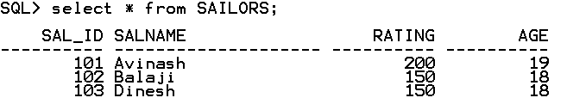
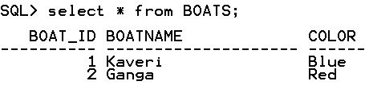
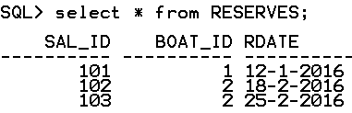
Problem to solve
9 December 2022

Slide 49
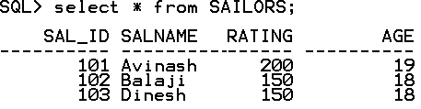
Problem to solve
Consider three tables
SAILORS(Sal_ID, SalName, Rating, Age)
RESERVES(Sal_ID , Boat-ID, Rdate)
BOATS(Boat-ID, BoatName, Color)
Write Relational Algebra express for the following
Find all the names of Sailors who have reserved boat with ID 2
OUTPUT
--------
Balaji
Dinesh
9 December 2022

Slide 50

Problem to solve
Consider three tables
SAILORS(Sal_ID, SalName, Rating, Age)
RESERVES(Sal_ID , Boat-ID, Rdate)
BOATS(Boat-ID, BoatName, Color)
Write Relational Algebra express for the following
Find all the names of Sailors who have reserved boat with ID 2
SELECT *
FROM RESERVES
WHERE Boat_ID = 2;
temp1 <- σ_{Boat_ID=2} ^{(RESERVES)}
temp1
9 December 2022

Slide 51

Problem to solve
Consider three tables
SAILORS(Sal_ID, SalName, Rating, Age)
RESERVES(Sal_ID , Boat-ID, Rdate)
BOATS(Boat-ID, BoatName, Color)
Write Relational Algebra express for the following
Find all the names of Sailors who have reserved boat with ID 2
temp1 <- σ_{Boat_ID=2} ^{(RESERVES)}
temp2 <- 𝞹_{SAL_ID}(temp1)
SELECT SAIL_ID
FROM RESERVES
WHERE Boat_ID = 2;
temp2
9 December 2022

Slide 52

Problem to solve
i. Find all the names of Sailors who have reserved boat with ID 2
temp1 <- σ_{Boat_ID=2} ^{(RESERVES)}
temp2 <- 𝞹_{SAL_ID}(temp1)
temp3 <- SAILORS ⋈ SAILORS.Sal_ID=temp2.Sal_ID (temp2)
temp3
SELECT *
FROM SAILORS
NATURAL JOIN
(SELECT SAL_ID
FROM RESERVES
WHERE Boat_ID = 2);
9 December 2022

Slide 53

Problem to solve
i. Find all the names of Sailors who have reserved boat with ID 2
temp1 <- σ_{Boat_ID=2} ^{(RESERVES)}
temp2 <- 𝞹_{SAL_ID}(temp1)
temp3 <- SAILORS ⋈ SAILORS.Sal_ID=temp2.Sal_ID (temp2)
result <- 𝞹_{SAL_Name}^{(temp3)}
result
SELECT SalName
FROM SAILORS
NATURAL JOIN
(SELECT SAL_ID
FROM RESERVES
WHERE Boat_ID = 2);
9 December 2022

Slide 54
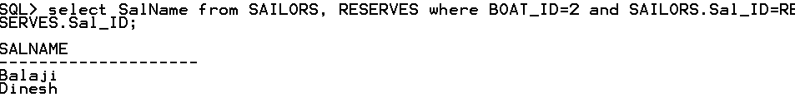
Problem to solve
i. Find all the names of Sailors who have reserved boat with ID 2
temp1 <- σ_{Boat_ID=2} ^{(RESERVES)}
temp2 <- 𝞹_{SAL_ID}(temp1)
temp3 <- SAILORS ⋈ SAILORS.Sal_ID=temp2.Sal_ID (temp2)
result <- 𝞹_{SAL_Name}^{(temp3)}
9 December 2022

Slide 55
SAILORS(Sal_ID, SalName, Rating, Age), RESERVES(Sal_ID , Boat-ID, Rdate), BOATS(Boat-ID, BoatName, Color)
Write Relational Algebra express for the following
ii. Find names of sailors who have reserved RED color boat
OUTPUT
--------
Balaji
Dinesh
9 December 2022

Slide 56
SAILORS(Sal_ID, SalName, Rating, Age), RESERVES(Sal_ID , Boat-ID, Rdate), BOATS(Boat-ID, BoatName, Color)
Write Relational Algebra express for the following
ii. Find the colors of the boat reserved by Avinash
OUTPUT
--------
Blue
9 December 2022

Slide 57
Join Operations
Join
Inner Join
Outer Join
Left Outer Join ⟕
Right Outer Join ⟖
Natural Join(*) (common attribute
names and domain
should exist between
two tables)
Full Outer Join ⟗
9 December 2022

Slide 58

Left Outer Join ⟕
result ← table1 ⟕ table2
table1
table2
result
ID | M
1 | a
2 | b
4 | c
ID | N
2 | p
3 | q
5 | r
ID | M | ID | N
2 | b | 2 | P
1 | a
4 | c
9 December 2022

Slide 59

Right Outer Join ⟖
result ← table1 ⟖ table2
table1
table2
result
ID | M
1 | a
2 | b
4 | c
ID | N
2 | p
3 | q
5 | r
ID | M | ID | N
2 | b | 2 | P
 |  | 3 | q
 |  | 5 | r
9 December 2022

Slide 60

Full Outer Join ⟗
result ← table1 ⟗ table2
table1
table2
result
ID | M
1 | a
2 | b
4 | c
ID | N
2 | p
3 | q
5 | r
ID | M | ID | N
2 | b | 2 | p
 |  | 3 | q
 |  | 5 | r
1 | a
4 | c
9 December 2022

Slide 61
Relational Algebra Set Operations - semantics
Consider two relations R and S.
UNION of R and S
the union of two relations is a relation that includes all the tuples that are either in R or in S or in both R and S. Duplicate tuples are eliminated.
INTERSECTION of R and S
the intersection of R and S is a relation that includes all tuples that are both in R and S.
DIFFERENCE of R and S
the difference of R and S is the relation that contains all the tuples that are in R but that are not in S.
For set operations to function correctly the relations R and S must be union compatible. Two relations are union compatible if
they have the same number of attributes
the domain of each attribute in column order is the same in both R and S.
9 December 2022

Slide 62
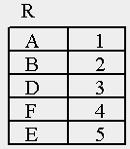
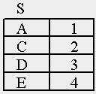
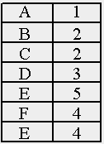
Set Operation – Union ∪
result
result ← R U S
9 December 2022

Slide 63

Set Operation – Intersection ∩
result
result ← R ∩ S
9 December 2022

Slide 64


Set Operation – Difference –
result ← R – S
result ← S – R
9 December 2022

Slide 65
Problem to Solve: Writing Relational Algebra Expression
Consider the following three tables
STUDENT(StudNum, StudName)
PROJECT(ProjNum, ProjArea)
ASSIGED_TO(StudNum,ProjNum)
i. Obtain student number and student name of all students who are working on both the projects having project number 75 and 81
ii. Obtain student number and student name of all those students who do not work on project number 68
iii. Obtain the student number and student name of all those students who are working on project with Area as “Database”
9 December 2022

Slide 66
Problem to Solve: Writing Relational Algebra Expression
Consider the following three tables
STUDENT(StudNum, StudName),
PROJECT(ProjNum, ProjArea), ASSIGED_TO(StudNum,ProjNum)
STUDENT
PROJECT
ASSIGNED_TO
StudNum | StudName
554 | Avinash
555 | Balaji
556 | Chandan
557 | Dinesh
558 | Harish
ProjNum | ProjArea
56 | Java
68 | Database
75 | Database
81 | Database
StudNum | Proj Num
554 | 56
555 | 68
556 | 75
556 | 81
557 | 75
9 December 2022

Slide 67
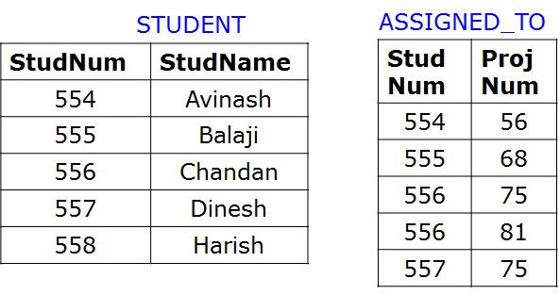
Problem to Solve: Writing Relational Algebra Expression
i. Obtain student number and student name of all students who are working on both the projects having project number 75 and 81
result
-----------------
556 Chandan
9 December 2022

Slide 68
Problem to Solve: Writing Relational Algebra Expression
i. Obtain student number and student name of all students who are working on both the projects having project number 75 and 81
result
-----------------
556 Chandan
temp1 <- σ_{ProjNum=75}(ASSIGNED_TO)
temp2 <- 𝞹_{StudNum}(temp1)
temp3 <- σ_{ProjNum=81}(ASSIGNED_TO)
temp4 <- 𝞹_{StudNum}(temp3)
temp5 <- temp2 ∩ temp4
result <- STUDENT ⋈ _{STUDENT.StudNum=temp5.StudNum} (temp5)
9 December 2022

Slide 69
Problem to Solve: Writing Relational Algebra Expression
ii. Obtain student number and student name of all those students who do not work on project number 68
STUDENT
ASSIGNED_TO
StudNum | StudName
554 | Avinash
555 | Balaji
556 | Chandan
557 | Dinesh
558 | Harish
StudNum | Proj Num
554 | 56
555 | 68
556 | 75
556 | 81
557 | 75
result
-----------------
Avinash
556 Chandan
557 Dinesh
558 Harish
9 December 2022

Slide 70
Problem to Solve: Writing Relational Algebra Expression
i. Obtain student number and student name of all those students who do not work on project number 68
result
-----------------
Avinash
556 Chandan
557 Dinesh
558 Harish
temp1 <- σ_{ProjNum=68}(ASSIGNED_TO)
temp2 <- 𝞹_{StudNum}(temp1)
temp3 <- 𝞹_{StudNum}(STUDENT)
temp4 <- temp3 – temp2
result <- STUDENT ⋈ _{STUDENT.StudNum=temp4.StudNum} (temp4)
9 December 2022

Slide 71
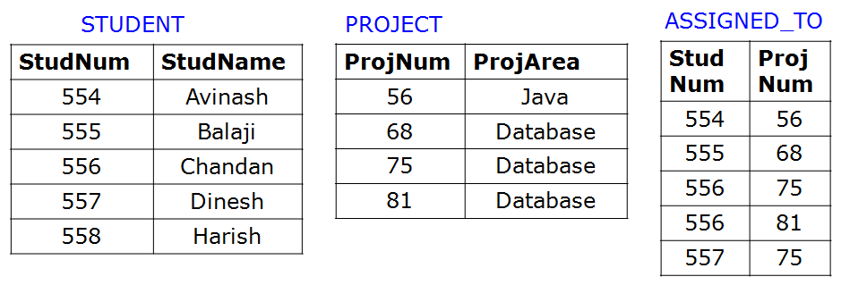
Homework Problem : Writing Relational Algebra Expression
iii. Obtain the student number and student name of all those students who are working on project with area as “Database”
result
-----------------
555 Balaji
556 Chandan
557 Dinesh
9 December 2022

Slide 72
Relational Algebra : Division Operation ÷
The division operator is used for queries which involve the ‘all’
qualifier such as
“Which persons have a bank account at ALL the banks in the country?”
“Which students are registered on ALL the courses given by Sonthos?”
“Which students are registered on ALL the courses that are taught in period 1?”
Find sailors who have reserved ALL boats
R ÷ S is used when we wish to express queries with “ALL”
9 December 2022
Notes:
Attribute related to all the attributes

Slide 73
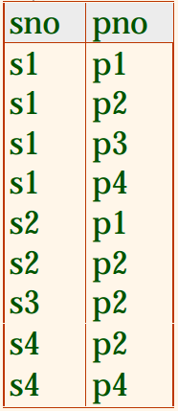
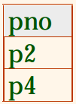

Relational Algebra : Division Operation ÷
  The division operator takes as input two relations, called the dividend relation
  (a on scheme A) and the divisor relation (b on scheme B) such that all the
  attributes in B also appear in A and B is not empty. The output of the division
  operation is a relation on scheme A with all the attributes common with B.
A
B
A ÷ B
9 December 2022

Slide 74
Relational Algebra : Division Operation ÷
  The division operator takes as input two relations, called the dividend relation
  (a on scheme A) and the divisor relation (b on scheme B) such that all the
  attributes in B also appear in A and B is not empty. The output of the division
  operation is a relation on scheme A with all the attributes common with B.
A
B
A ÷ B
9 December 2022

Slide 75
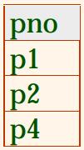

Relational Algebra : Division Operation ÷
A
A ÷ B
B
9 December 2022

Slide 76
Relational Algebra : Division Operation ÷
Completed
DBProject
Student | Task
Feroz | Database1
Feroz | Database2
Feroz | Compiler1
Eshwar | Database1
Sara | Database1
Sara | Database2
Eshwar | Compiler1
Task
Database1
Database2
What is the Output of the following
relational Algebra Expression
Completed ÷ DBProject
9 December 2022
Notes:
The division operator takes as input two relations, called the dividend relation (r on scheme R) and the divisor relation (s on scheme S) such that all the attributes in S also appear in R and S is not empty. The output of the division operation is a relation on scheme R with all the attributes common with S.

Slide 77
Relational Algebra : Division Operation ÷
Completed
DBProject
Completed ÷ DBProject
Student | Task
Feroz | Database1
Feroz | Database2
Feroz | Compiler1
Eshwar | Database1
Sara | Database1
Sara | Database2
Eshwar | Compiler1
Task
Database1
Database2
Student
Feroz
Sara
9 December 2022
Notes:
The division operator takes as input two relations, called the dividend relation (r on scheme R) and the divisor relation (s on scheme S) such that all the attributes in S also appear in R and S is not empty. The output of the division operation is a relation on scheme R with all the attributes common with S.

Slide 78
Relational Algebra : Division Operation ÷
Completed
DBProject
Completed ÷ DBProject
Student | Task
F | D1
F | D2
F | C1
E | D1
E | C1
Task
D1
D2
Student
F
Is the following two relational
algebra expressions logically equivalent ?
T ← Completed ÷ DBProject
T₁ ← 𝞹_{Student}(Completed)
T₂ ← T₁ × DBProject
T₃ ← T₂ - Completed
T₄ ← 𝞹_{Student} (T₃ )
T ← T₁ - T₄
9 December 2022
Notes:
The division operator takes as input two relations, called the dividend relation (r on scheme R) and the divisor relation (s on scheme S) such that all the attributes in S also appear in R and S is not empty. The output of the division operation is a relation on scheme R with all the attributes common with S.

Slide 79
Write relational Algebra Expresion
Find all bank customers who have account in all Branches of Bommasandra
Account
Branch
cid | branch_id | acct_no | balance
1 | 52 | 8103 | 43101.45
3 | 53 | 4826 | 752.80
1 | 53 | 7898 | 48206.10
2 | 59 | 2135 | 468923.06
1 | 59 | 1290 | 456.50
2 | 54 | 0073 | 1006.28
branch_id | branch_city
51 | Belgaum
52 | Bijapur
53 | Bommasandra
54 | Hubli
55 | Bijapur
59 | Bommasandra
Customer
cid | c_name
1 | Harish
2 | Triveni
3 | Eshwar
RESULT
c_name
Harish
9 December 2022
Notes:
http://www.cs.montana.edu/~halla/csci440/n6/n6.html#division

Slide 80
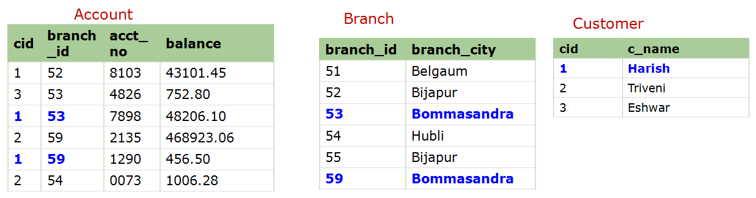
Find all bank customers who have account in all Branches in Bommasandra
BommB ← 𝞹 _{branch_id}(σ_{branch_city='Bommasandra'}(Branch)) --find all branches
located
in Bommansandra
BommB
branch_id
53
59
9 December 2022
Notes:
http://www.cs.montana.edu/~halla/csci440/n6/n6.html#division

Slide 81
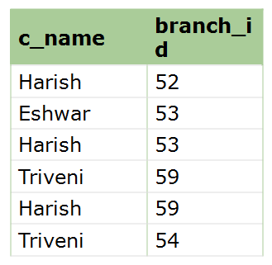
Find all bank customers who have account in all Branches in Bommasandra
BommB ← 𝞹 _{branch_id}(σ_{branch_city='Bommasandra'}(Branch)) --find all branches located
in Bommansandra
CB ← 𝞹 _{c_name,branch_id}(Customer * Account) -- find all customers' branches
BommB
CB
branch_id
53
59
9 December 2022
Notes:
http://www.cs.montana.edu/~halla/csci440/n6/n6.html#division

Slide 82
Find all bank customers who have account in all Branches in Bommasandra
BommB ← 𝞹 _{branch_id}(σ_{branch_city='Bommasandra'}(Branch)) --find all branches located
in Bommansandra
CB ← 𝞹 _{c_name,branch_id}(Customer * Account) -- find all customers' branches
RESULT ← CB ÷ BommB -- divide to get those customers with an
account in every Bommasandra branch
BommB
CB
RESULT
branch_id
53
59
c_name
Harish
9 December 2022
Notes:
http://www.cs.montana.edu/~halla/csci440/n6/n6.html#division

Slide 83
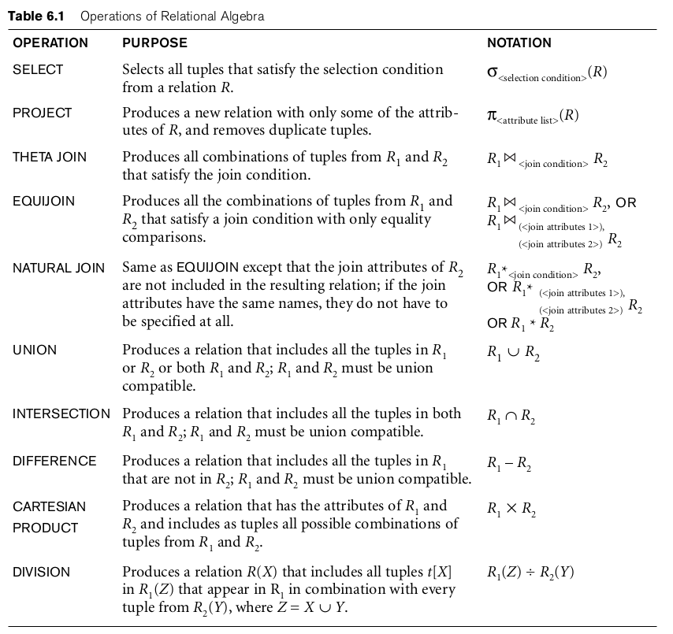
9 December 2022
CSE, BMSCE

Slide 84
Query Tree Notation
Query Tree
  An internal data structure to represent a query
  Standard technique for estimating the work involved in executing the query, the generation of intermediate results, and the optimization of execution
  Nodes stand for operations like selection, projection, join, renaming, division, ….
  Leaf nodes represent base relations
  A tree gives a good visual feel of the complexity of the query and the operations involved
  Algebraic Query Optimization consists of rewriting the query or modifying the query tree into an equivalent tree.
9 December 2022
Notes:
After all, it's not a query language for any DBMS. But it is useful for formal analysis of relational db operations, and as an SQL “intermediate form” for query planning and optimization.

Slide 85


Query Tree Notation: Example
Write query: For every project located in ‘Surat’, list the project number, the controlling department number, and the department manager's last name, address, and birth date.
9 December 2022

Slide 86
Query Tree Notation: Example
Example: For every project located in ‘Surat’, list the project number, the controlling department number, and the department manager's last name, address, and birth date.
𝞹Pnumber, Dnum, Lname, Address, Bdate ((σ_{Plocation='Surat'}(Project) ⋈_{Dnum=Dnumber} Department) ⋈_{Mgr_ssn=Ssn} Employee)
9 December 2022

Slide 87
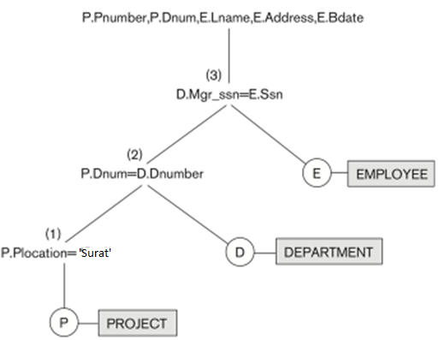
Query Tree Notation: Example
𝞹Pnumber, Dnum, Lname, Address, Bdate (
(σ_{Plocation='Surat'}(Project) ⋈_{Dnum=Dnumber}Department)⋈_{Mgr_ssn=Ssn} Employee)
_{𝞹}
⋈
⋈
σ
9 December 2022
CSE, BMSCE

Slide 88
Generalized Projection 𝞹
Extends the projection operation by allowing arithmetic functions to be used in the projection list.
𝞹 _{F1, F2, …, Fn}(E)
E is any relational-algebra expression
Each of F₁, F₂, …, F_{n} are are arithmetic expressions involving constants and attributes in the schema of E.
9 December 2022

Slide 89
Generalized Projection 𝞹
Given relation
credit-info(CustomerName, Limit, CreditBalance)
Find how much money each person can spend:
Customer-name | Limit | CreditBalance
Avinash | 2000 | 500
Balaji | 700 | 100
Chandan | 1500 | 1000
9 December 2022

Slide 90
Generalized Projection 𝞹
Given relation
credit-info(CustomerName, Limit, CreditBalance)
Find how much money each person can spend:
result <- ∏customer-name, (limit – credit-balance) (credit-info)
Customer-name | Limit | CreditBalance
Avinash | 2000 | 500
Balaji | 700 | 100
Chandan | 1500 | 1000
Customer-name | Limit - CreditBalance
Avinash | 1500
Balaji | 600
Chandan | 500
9 December 2022

Slide 91
Generalized Projection 𝞹
Another Example
Consider a relation
EMPLOYEE(EMP-ID, Salary, Deduction, Years-of-Service)
A report may be required to show:
Net_salary = Salary – Deduction
Bonus = 2000 * Years-of-Service
Tax = Salary * 25%
Then a generalized projection combined with renaming may be:
report _{<-} ρ_{(Net_salary, Bonus, Tax )}
(𝞹 _{EMP-ID,}
(Salary –Deduction), (2000 * Years-of-Service), (Salary * 0.25)
(EMPLOYEE))
9 December 2022N

Slide 92
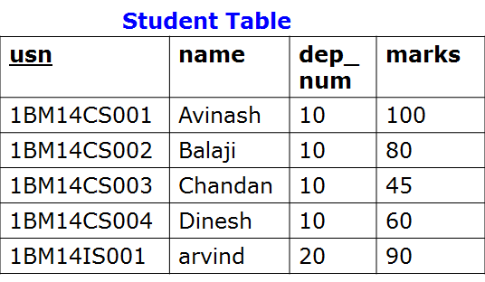
Aggregate Function ℱ (script F)
Aggregate functions return a single value, calculated from values in a column.
Useful aggregate functions:
AVG() - Returns the average value
COUNT() - Returns the number of rows
MAX() - Returns the largest value
MIN() - Returns the smallest value
SUM() - Returns the sum
ℱ_{MAX marks} (Student)
MAX_marks
-------------
100
9 December 2022

Slide 93
Aggregate Function ℱ (script F)
ℱ_{COUNT usn, AVERAGE} _{marks}(Student)
COUNT_usn AVERAGE_marks
---------------------------------
5 75
9 December 2022

Slide 94
Using Grouping with Aggregation
<grouping attribute> ℱ <aggregate function list>
<grouping attribute> is a list of attributes of the relation specified in R and <aggregate function list> is a list of (<function> <attribute>)
_{dep_num}ℱ_{COUNT usn, AVERAGE} _{marks}(Student)
dep-num COUNT_usn AVERAGE_marks
---------------------------------------------
10 4 71.25
20 1 90
9 December 2022

Slide 95
Problem to Solve: Writing Relational Algebra Expression
Consider the following three tables
SALESPERSON(SalesPersonID,Name)
TRIP(SalesPersonID, From, To, Trip-ID)
EXPENSE(TripID, Amount)
i. Print the total trip expenses incurred by sales person with ID 504
ii. Give the trip details for the trip that exceeded Rs. 10,000/-
iii. Print the sales person ID and Name of the sales men who took trips to Delhi
9 December 2022

Slide 96
Problem to Solve: Writing Relational Algebra Expression
Consider the following three tables
SALESPERSON(SalesPersonID,Name)
TRIP(SalesPersonID, From, To, Trip-ID)
EXPENSE(TripID, Amount)
SALESPERSON
EXPENSE
SalesPersonID | Name
504 | Avinash
505 | Balaji
506 | Chandan
Trip-ID | Amount
10 | 10000
11 | 8000
12 | 15000
TRIP
SalesPersonID | From | To | Trip-ID
504 | Chennai | Delhi | 10
504 | Bangalore | Bombay | 11
505 | Bangalore | Srinagar | 12
9 December 2022

Slide 97
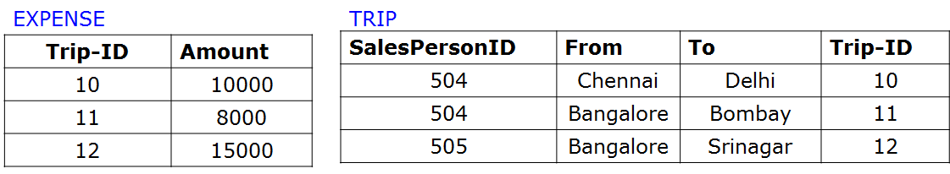
Problem to Solve: Writing Relational Algebra Expression
i. Print the total trip expenses incurred by sales person with ID 504
result
--------
18000
9 December 2022

Slide 98
Problem to Solve: Writing Relational Algebra Expression
i. Print the total trip expenses incurred by sales person with ID 504
result
--------
18000
temp1 <- σ_{SalespersonID=504}(TRIP)
temp2 <- 𝞹_{Trip-ID}(temp1)
temp3 <- EXPENSE ⋈ _{EXPENSE.Trip-ID=temp2.Trip-ID} (temp2)
result <- ℱ_{SUM Amount} (temp3)
9 December 2022

Slide 99
Problem to Solve: Writing Relational Algebra Expression
ii. Give the trip details for the trip that exceeded Rs. 10,000/-
result
----------------------------------------
504 Chennai Delhi 10 10000
505 Bangalore Srinagar 12 15000
9 December 2022

Slide 100
Problem to Solve: Writing Relational Algebra Expression
ii. Give the trip details for the trip that exceeded Rs. 10,000/-
result
----------------------------------------
504 Chennai Delhi 10 10000
505 Bangalore Srinagar 12 15000
temp1 <- σ_{Amount > 10000}(EXPENSE)
result <- 𝞹 (TRIP.SalesPersonID, TRIP.From, TRIP.To, TRIP.Trip-ID,temp2.Amount) (TRIP ⋈
_{TRIP.Trip-ID=temp1.Trip-ID} (temp1))
9 December 2022

Slide 101
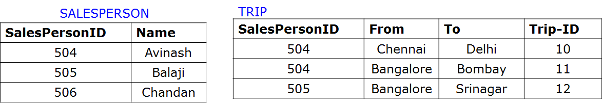
Problem to Solve: Writing Relational Algebra Expression
iii. Print the sales person ID and Name of the sales men who took trips to Delhi
result
--------------
504 Avinash
9 December 2022

Slide 102
Problem to Solve: Writing Relational Algebra Expression
iii. Print the sales person ID and Name of the sales men who took trips to Delhi
result
--------------
504 Avinash
temp1 <- σ_{To=‘Delhi’}(TRIP)
temp2 <- 𝞹_{SalesPerson-ID}(temp1)
temp3<-SALESPERSON ⋈ SALESPERSON.SalesPersonID=temp2.SalesPerson-ID (temp2)
result <- 𝞹 _{SalesPersonID, Name} (temp3)
9 December 2022

Slide 103
Problem to Solve: Writing Relational Algebra Expression
Consider the following relational schema describing a movie database
Schedule(Theater, Title, Time)
Movies(Title, Director, Actor)
Produced(Producer, Title)
See(Spectator, Title)
Liked(Spectator, Title)
A movie is directed by only one director but can be produced by several Producers. A spectator may like a movie without having seen it. Write the following two queries in both Relational Algebra and SQL.
Note: In relational algebra you must use the expression form and are not allowed to use linear sequence or expression trees. You are also NOT allowed renaming of relations. You may use renaming of attributes. You may use numerical comparisons (e.g. R:A > 5) in both SQL and Relational Algebra.
List the people who liked movies that they have not seen
List the producers who produced a movie that does not appear in a theater.
9 December 2022
Notes:
https://www.cse.iitb.ac.in/~cs317/Resources/solutions/Quiz2Solutions.pdf

Slide 104
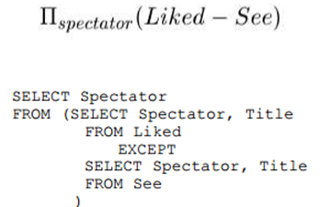
Problem to Solve: Writing Relational Algebra Expression
See(Spectator, Title)
Liked(Spectator, Title)
List the people who liked movies that they have not seen
9 December 2022
Notes:
https://www.cse.iitb.ac.in/~cs317/Resources/solutions/Quiz2Solutions.pdf

Slide 105
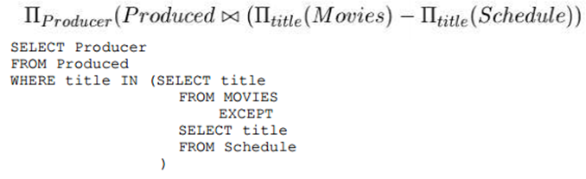
Problem to Solve: Writing Relational Algebra Expression
Schedule(Theater, Title, Time)
Movies(Title, Director, Actor)
Produced(Producer, Title)
List the producers who produced a movie that does not appear in a theater.
9 December 2022
Notes:
https://www.cse.iitb.ac.in/~cs317/Resources/solutions/Quiz2Solutions.pdf

Slide 106
Recursive Closure Operations
Another type of operation that, in general, cannot be specified in the basic original relational algebra is recursive closure. This operation is applied to a recursive relationship between tuples of the same type, such as the relationship between an employee and a supervisor.
  An example of a recursive operation is to retrieve all SUPERVISEES of an EMPLOYEE e at all levels — that is, all EMPLOYEE e’ directly supervised by e; all employees e’’ directly supervised by each employee e’; all employees e’’’ directly supervised by each employee e’’; and so on.
Although it is possible to retrieve employees at each level and then take their union, we cannot, in general, specify a query such as “retrieve the supervisees of ‘James Borg’ at all levels” without utilizing a looping mechanism.
9 December 2022

Slide 107
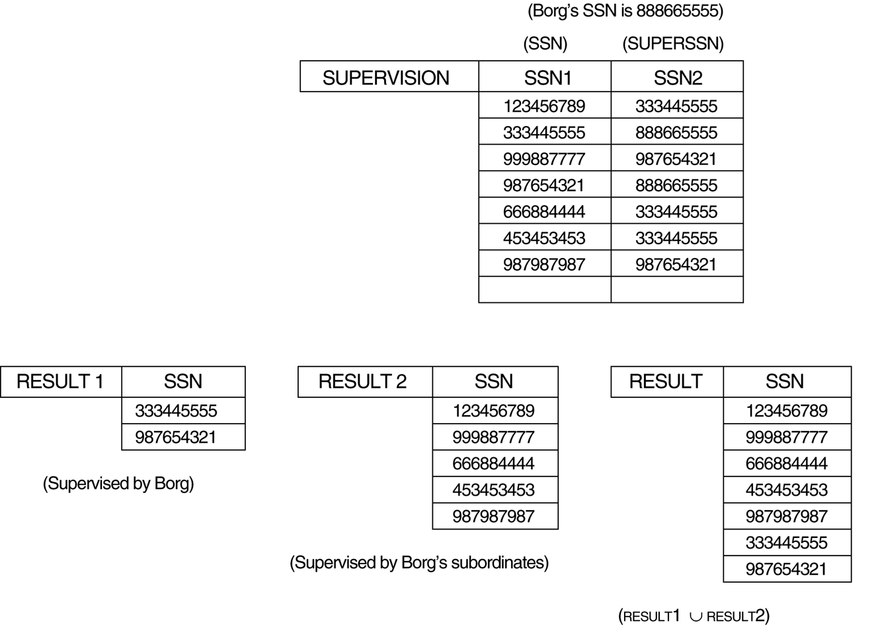
Recursive Closure Operations
9 December 2022

Slide 108
For example, to specify the codes of all employees and ‘directly supervised employees’ ⎯ ⎯ at level one by whose name is’ James Borg’, it is possible to apply the following operations:
BORG_NSS ← 𝞹 NSS (σ PNAME = ‘James’ AND SNAME = ‘Borg’ (EMPLOYEE))
SUPERVISION (SNN1, SNN2) ← 𝞹 NSS, NSSSUPER (EMPLOYEE)
RESULT1 ← 𝞹 SNN1 (SUPERVISION ⋈ SNN2 = NSS BORG_NSS)
To retrieve all employees supervised by Borg at level two, i.e., all employees and ‘ employees supervised by the first employee’ and that is directly supervised by Borg, you can apply another JOIN to the result of the first query:
RESULT2 ← 𝞹 SNN1 (SUPERVISION ⋈ SNN2 = NSS RESULT1)
For all employees supervised at levels one and two of ‘James Borg’, you can apply the UNION operation as follows:
RESULT3 ← (RESULT1 ∪ RESULT2)
9 December 2022

Slide 109
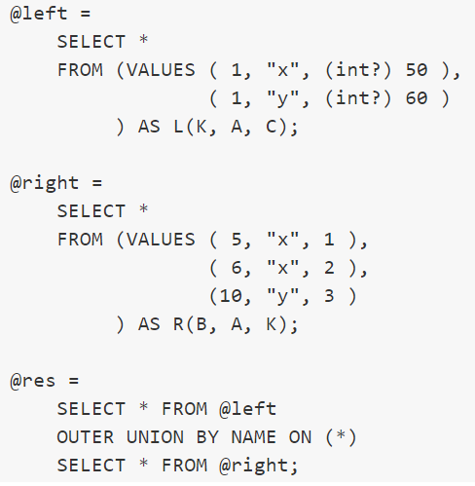
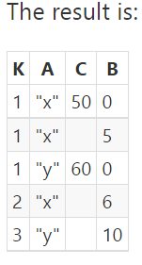
The OUTER UNION Operation
The OUTER UNION operation was developed to take the union of tuples from two relations that have some common attributes, but are not union (type) compatible. This operation will take the UNION of tuples in two relations R(X, Y) and S(X, Z) that are partially compatible, meaning that only some of their attributes, say X, are union compatible. The attributes that are union compatible are represented only once in the result, and those attributes that are not union compatible from either relation are also kept in the result relation T(X, Y, Z). It is therefore the same as a FULL OUTER JOIN on the common attributes.
9 December 2022

Slide 110
Relational Algebra Operations
Unary Operations - operate on one relation. These include select, project and rename operators.
Binary Operations - operate on pairs of relations. These include union, set difference, intersection, division, cartesian product, join, equality join, natural join, Left Outer join, Right outer join and full outer join.
9 December 2022

Slide 111
Thank You for Your Time and Attention !
Students Should read through the
-Relational algebra example queries given in the ELMARSI and NAVATHE text book in chapter 6 of section 6.5
9 December 2022

Slide 112
Homework Problem: Writing Relational Algebra Expression
iv. Obtain student number and student name of all students other than the student with number 554 who works on atleast one project.
result
-----------------
555 Balaji
556 Chandan
557 Dinesh
9 December 2022

